Slide 1

Submitted by Harshal Bondre

Slide 2
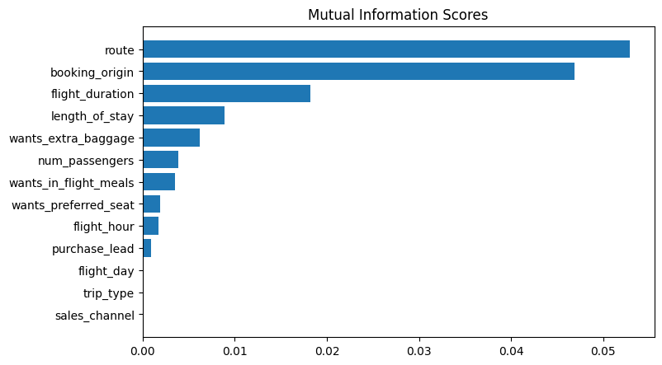
We have trained the data set with Random forest classifier model and received
ACCURACY: 84.84
AUC score: 0.5527766076821664
Route, Booking origin, Flight Duration, Length of stay and wants extra baggage are top 5 features on which it depends
Thus, we can conclude that we can increase AUC score.

